Slide 1
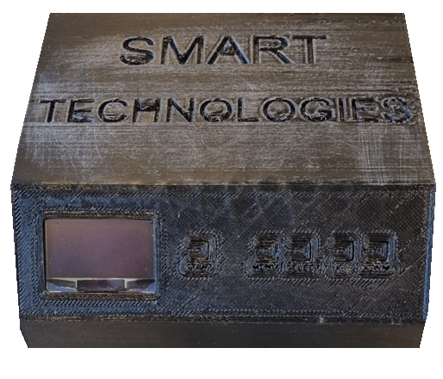
Control a stepper motor
Ayman & Chris

Slide 2

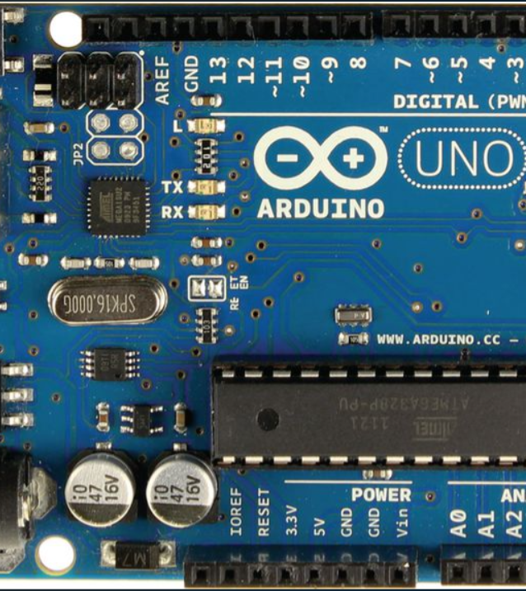

Contents
Introduction
What is a stepper motor?
How we can drive it?
Driving techniques
Flowchart of the main program
Flowchart of state machine
Wiring Diagram
3D Printed Box

Slide 3

Introduction:
Task:
Control Bipolar Stepper Motor „without libraries“:
Direction
Steps
(additional: Speed, Modes)
Built up a circuit: (including)
Driver
OLED-Display
Arduino Uno
Buttons 5x
Powersupply

Slide 4
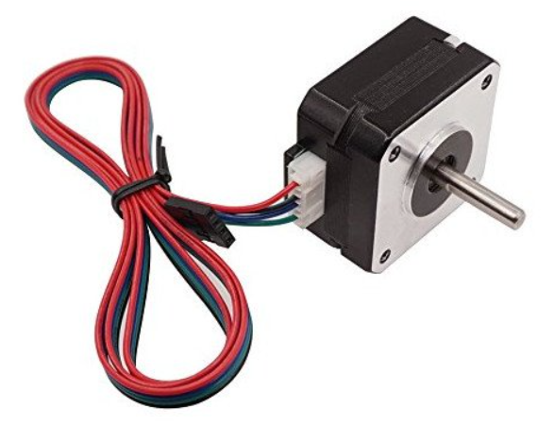
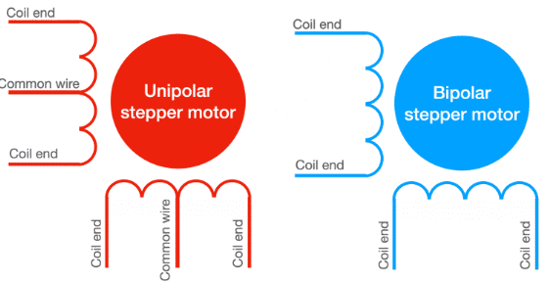
What is a stepper motor?
Is a brushless, synchronous electric motor
converts digital pulses into mechanical shaft rotation
our motor (SM-17HS4023) can manage:
1.8° per step
Full rotation 360° in 200 steps
There are 2 types of stepper motor which exists:
Unipolar (divided coils)
Bipolar

Slide 5
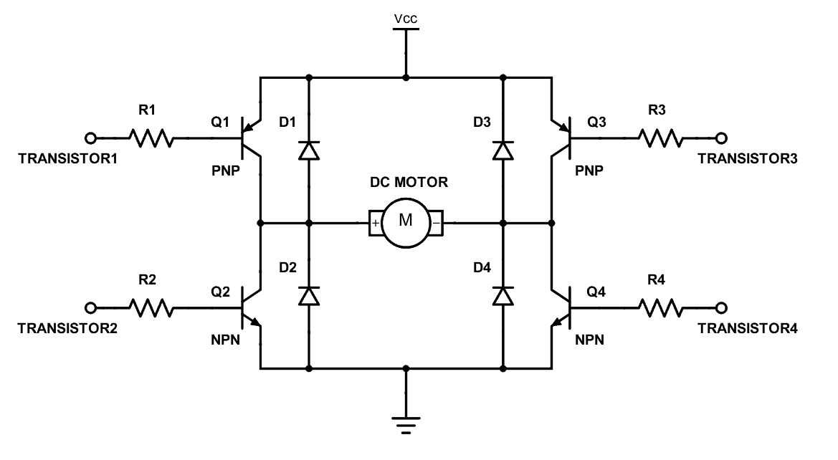
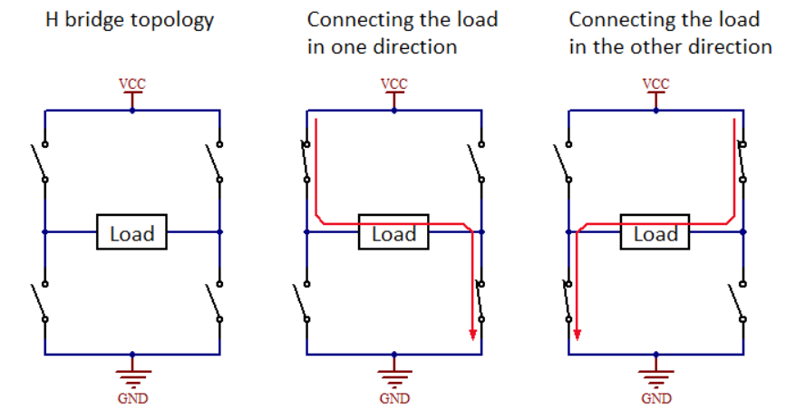
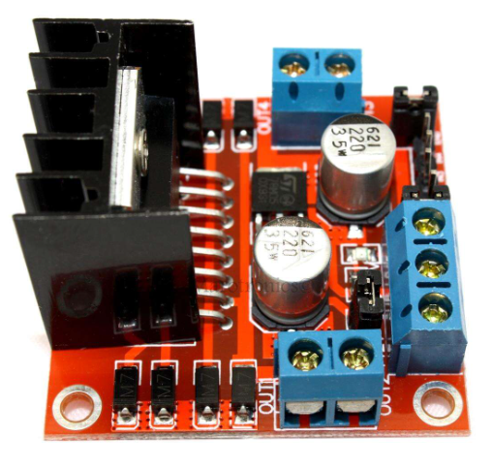
What do we need to drive it?
Full H-Bridge
L298N Full H-Bridge Driver

Slide 6
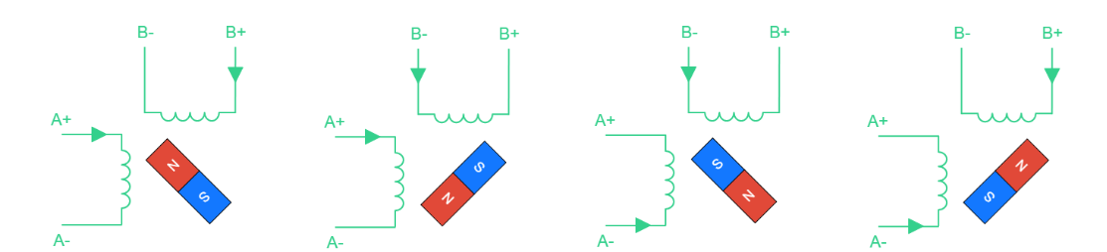
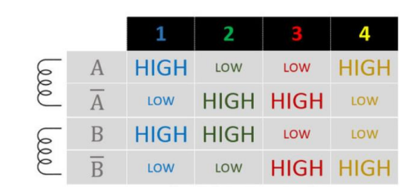
Driving techniques
Modes
Wave step mode
Full-step mode
Half-step mode
Microstepping mode

Slide 7
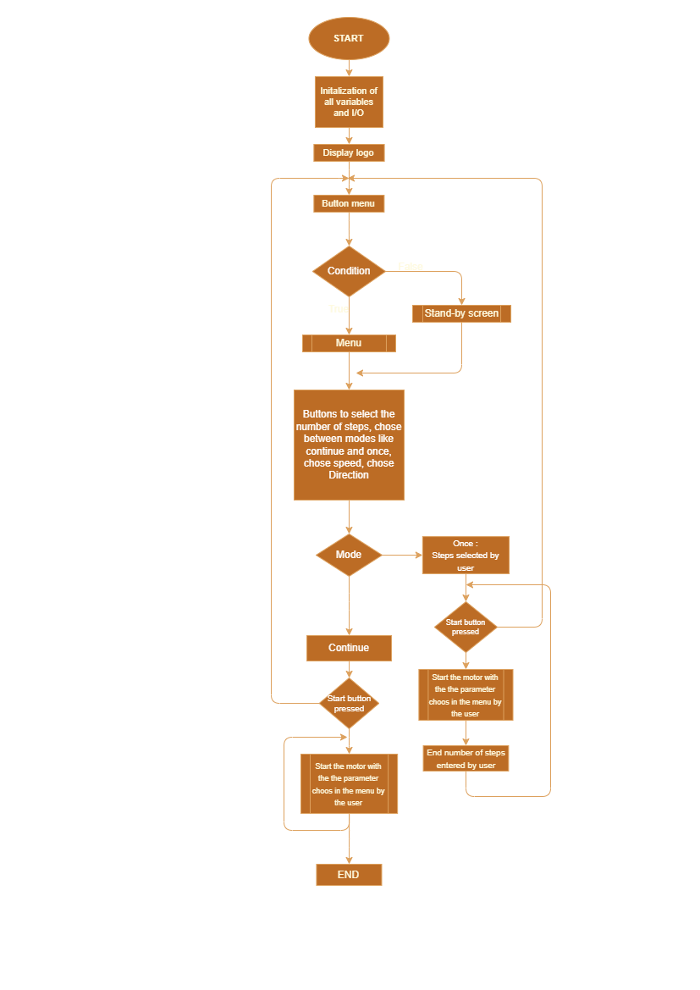
Flowchart: Program

Slide 8
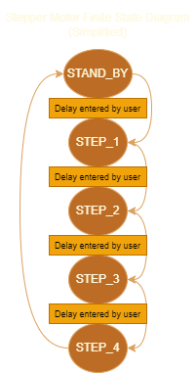
Flowchart of state machine
Wait until button pressed (START)
Choose parameters

Slide 9
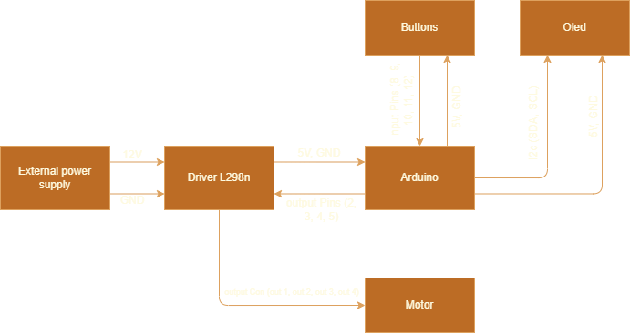
Wiring Diagram

Slide 10
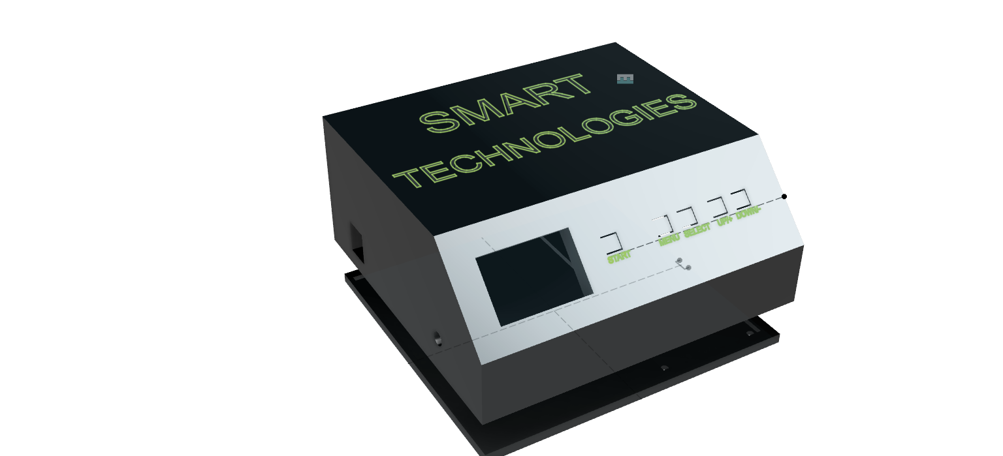
3D printed Box

Slide 11
Thank you for your attention

